Slide 1
INDUSTRY SPONSOR
Country Web Intelligence Mining

Slide 2

OVERVIEW
Business Problem
Assumptions
Approach + Decisions Taken
Code Operations + Outputs
Processing and Automation
PowerBI Dashboard Outputs Demo

Slide 3


BUSINESS PROBLEM
Problem Breakdown:
Business Need: Automate country intelligence gathering to identify key defense activities.
Analytics Approach: Leverage web scraping, dashboards, and machine learning to extract and rank relevant defense insights.
Potential Solutions?
Web Scraping: BeautifulSoup, Selenium, or Microsoft's Power Automate
Visualization: PowerBI or Tableau for dashboards that can be converted to PPT.
ML Approach: Sentiment analysis for more in depth insights

Slide 4

REQUIREMENTS GATHERING
BIG QUESTIONS WE ASKED OURSELVES?
Where will our data come from?
What websites?
How will we structure the data?
Coding in specific formats for easy-to-read file outputs? Can PowerBI or Tableau understand the outputs?
Can we script the data to be pulled through one easy push of a button?
Automation in the code processes? Making it as easy as possible to use? Army-proof?
What will our data look like in a visualization tool?
Is it easy to use? What insights can be extracted? Are they useful?

Slide 5
PICKING A WAY FORWARDS
We had two paths to choose from at an early stage:
1
2
Utilize and improve upon Python library scraping methods through either BeautifulSoup or Selenium packages | Create a workflow process through an agentic AI process (autonomous task completing intelligence)
PROs: Proven time and time again, easy to use and learn, very VERY flexible | PROs: Straightforwards and easy to build a flow – no real coding experience needed
CONs: Requires some coding understanding to properly use, can be complex depending on websites being scraped | CONs: Microsoft Power Automate poses challenges like a learning curve, issues with GPT scraping defense data, and unreliable data since it's sourced via GPT.

Slide 6
ATTEMPTING AGENTIC AI

Slide 7
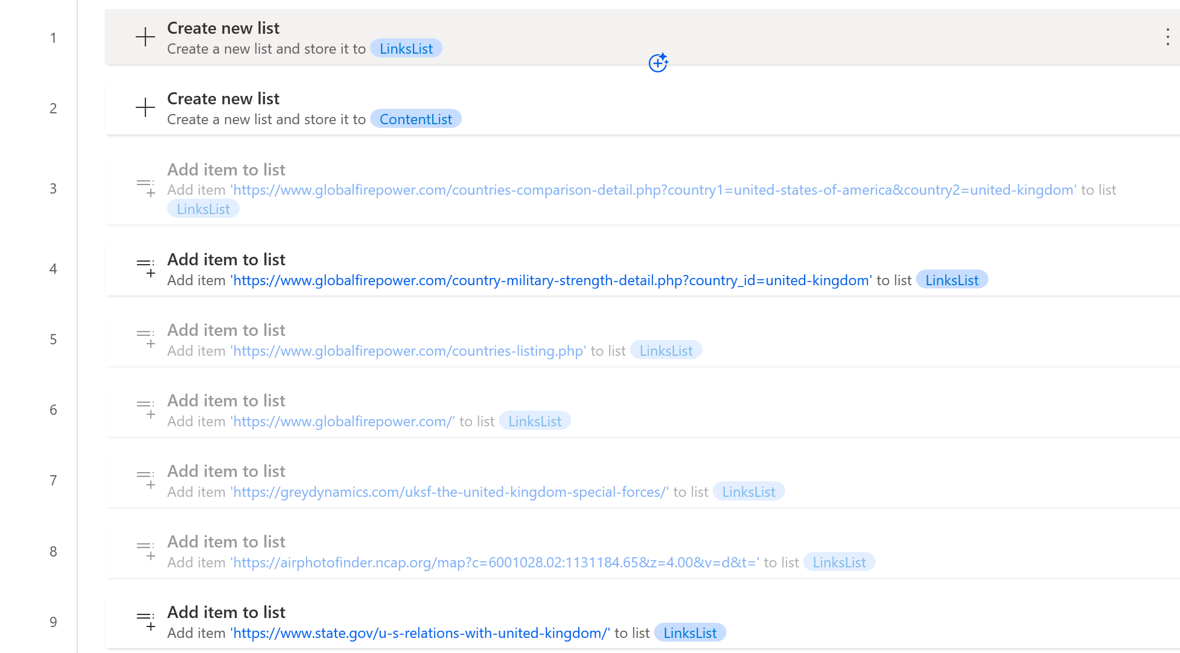
MICROSOFT POWER AUTOMATE
Step 1
Create a list
Step 2
Add website URLs to list

Slide 8
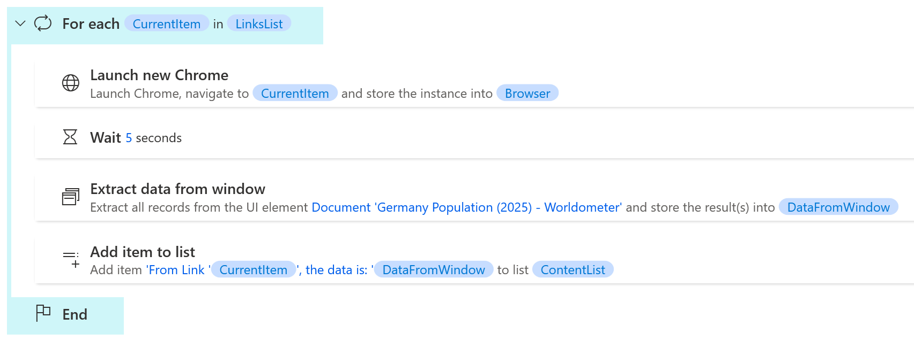
MICROSOFT POWER AUTOMATE
*Current Item: each website in list (Links list is the same list from above that was created in Step 1)
Step 3
Create for each loop (same concept as Python For loop), Launch Chrome for scraping.
Step 4
Extract data from window function and store it into a variable (DataFromWindow)
Step 5
Add function and store it into a variable (DataFromWindow). Associate each website link in the Linkslist to an extracted data pull.

Slide 9
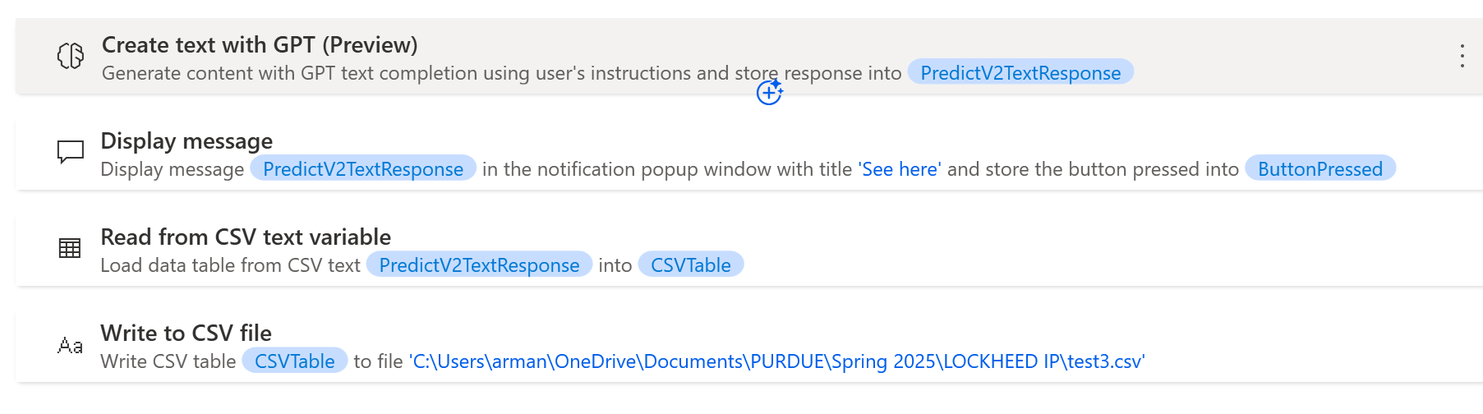
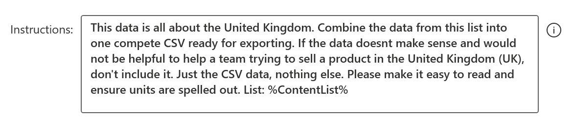
MICROSOFT POWER AUTOMATE
*Current Item: each website in list (Links list is the same list from above that was created in Step 1)
Step 6
Utilizing in-built AI GPT to prompt CSV creation
Step 6
Load and write the file into CSV format.

Slide 10

ISSUES WITH MICROSOFT POWER AUTOMATE
Microsoft's GPT not flexible with inputs – lots of issues running the flows
Power Automate's user interface is very specific and requires training to understand fully.
Time savings are not noticeable enough to warrant a full switch over
OUR CONCLUSION -- The MAIN issue is the GPT, it cannot properly process inputs regarding defense data being extracted for CSV outputs.

Slide 11
Python web scraping

Slide 12



WEB SCRAPING WITH BEAUTIFULSOUP + SELENIUM
FIRST, we split up to focus on specific sections of data to scrape for each country:
Such as -- Defense/Economics/Demographics/and others...
SECOND, we each created workflow processes and assumptions for our respective sections:
To help reproduce our results
THIRD, we combined our codes and dashboards into a centralized location for use:
Easy code script to run from one place/centralized github repository/one dashboard on PowerBI

Slide 13
SOURCES – WEBSITES WE SCRAPED DATA FROM
For our project, we collected data from various reliable public sources, including:
🌍 Economic & Trade Data:
Trading Economics (https://tradingeconomics.com/countries)
Macrotrends (https://www.macrotrends.net/global-metrics/countries)
🛡 Military Data:
Global Firepower (https://www.globalfirepower.com/)
World Directory of Modern Warships (https://www.wdmmw.org/)
🌿 Natural Resources & Geography:
CIA World Factbook (https://www.cia.gov/the-world-factbook/)
UN Environment Programme (https://www.unep.org/)
🌦 Climate Data:
NOAA Climate Data (https://www.ncdc.noaa.gov/)
World Meteorological Organization (https://public.wmo.int/en)

Slide 14
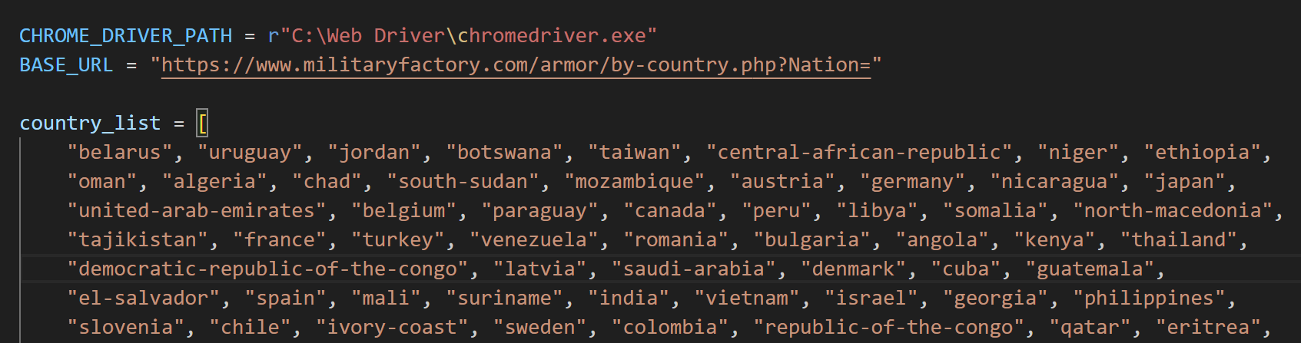
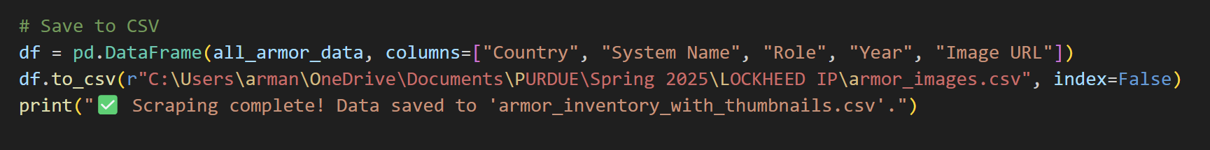
DATA PROCESSING + AUTOMATION
Figuring out website URLs to create efficient scrapers
Creating neat CSV outputs

Slide 15
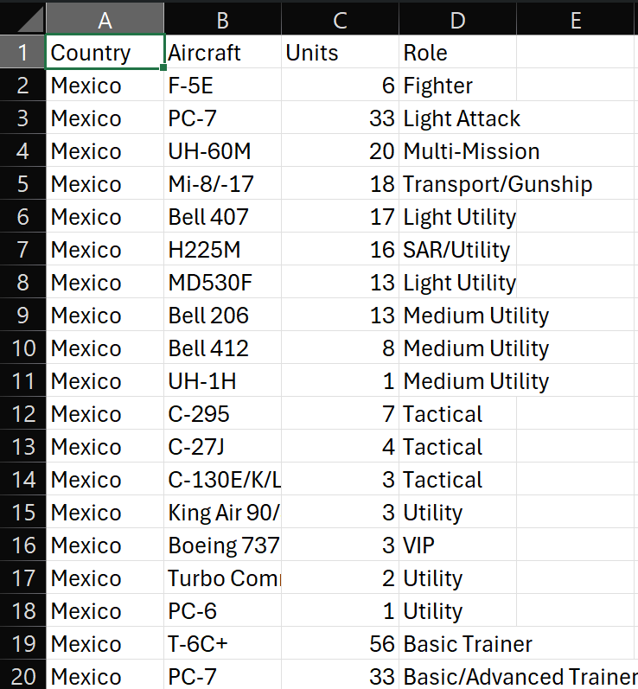

DATA PROCESSING + AUTOMATION
GOAL create clean and easily digestible CSV files that can be transferred to visualization tools
SMOOTH data transfers to decrease time spent debugging and fixing CSV files

Slide 16
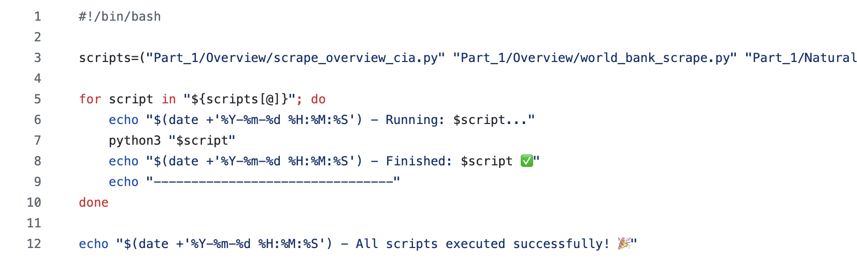
DATA PROCESSING + AUTOMATION
We created a script that centralizes the running of code for ease of use

Slide 17
DASHBOARDS

Slide 18
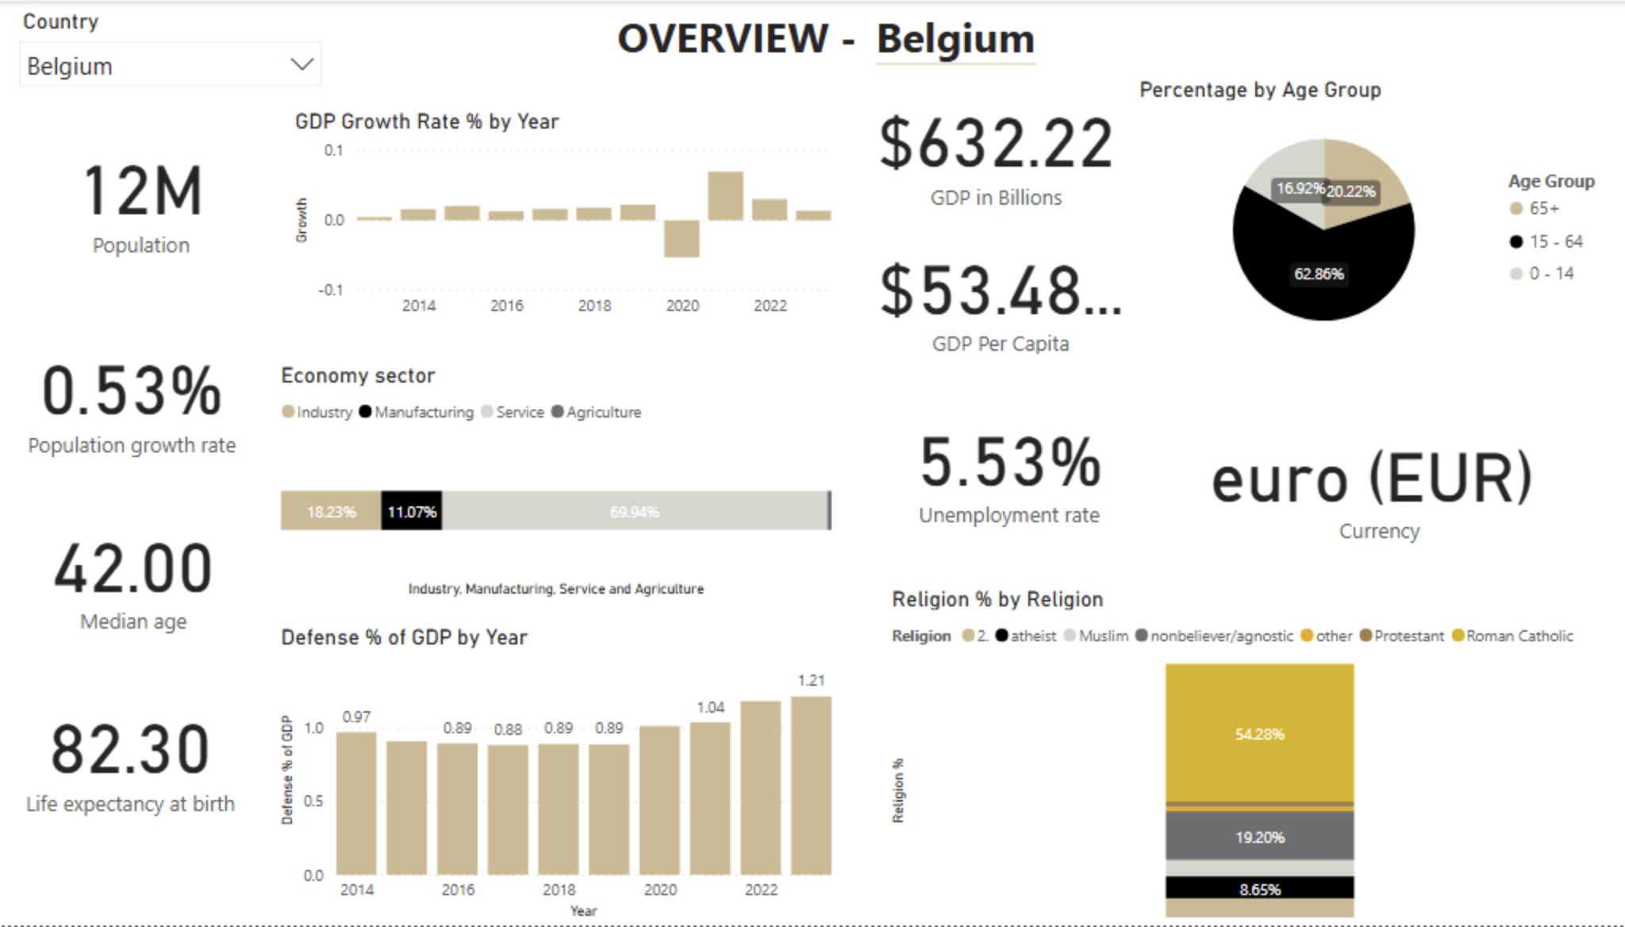
OVERVIEW

Slide 19
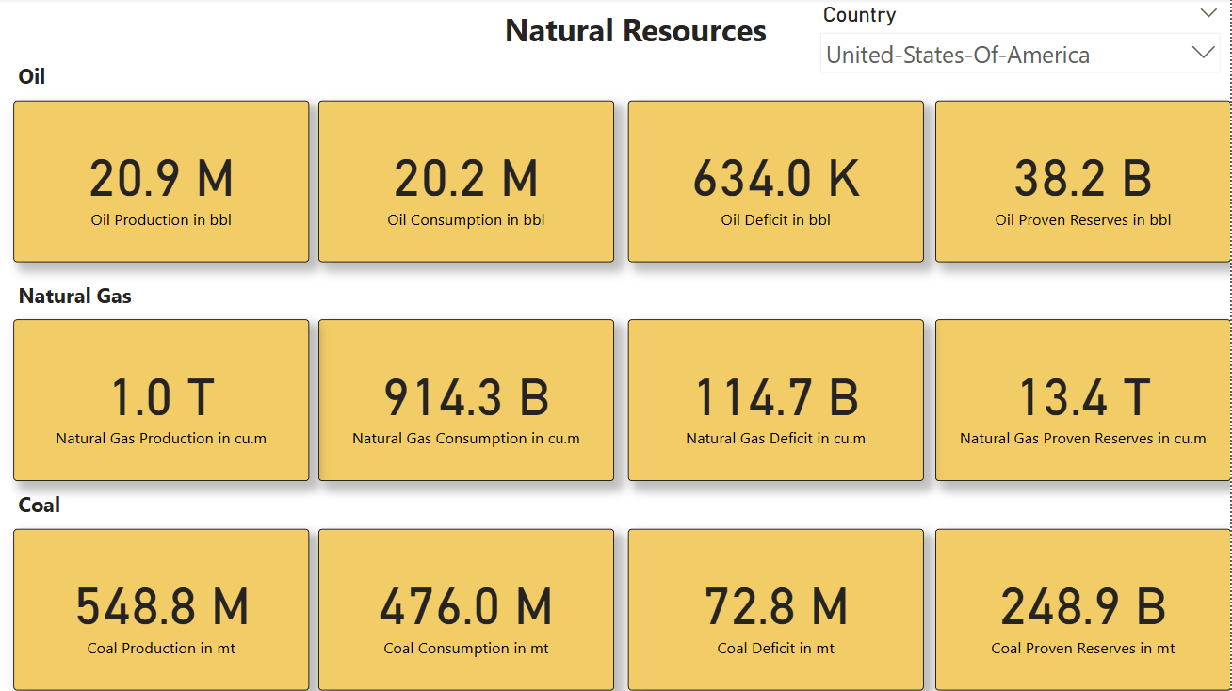
Natural Resources

Slide 20
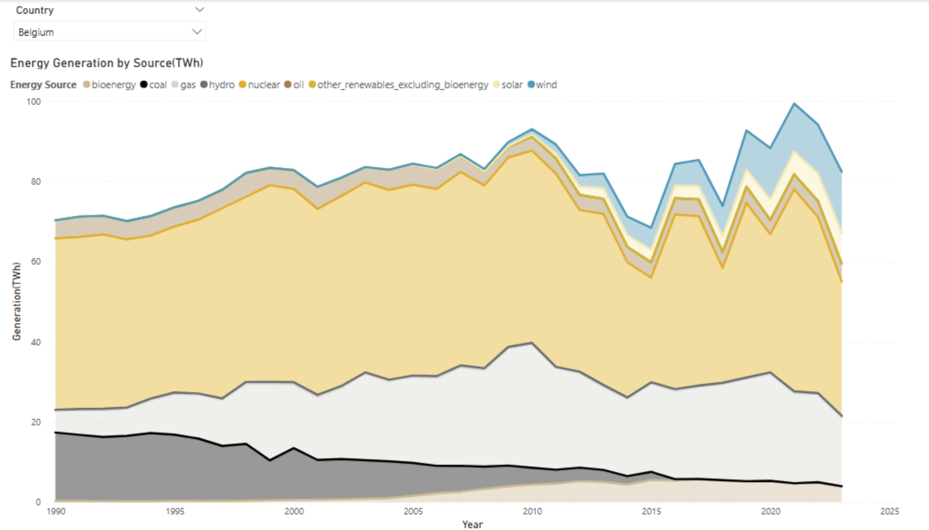
Energy

Slide 21
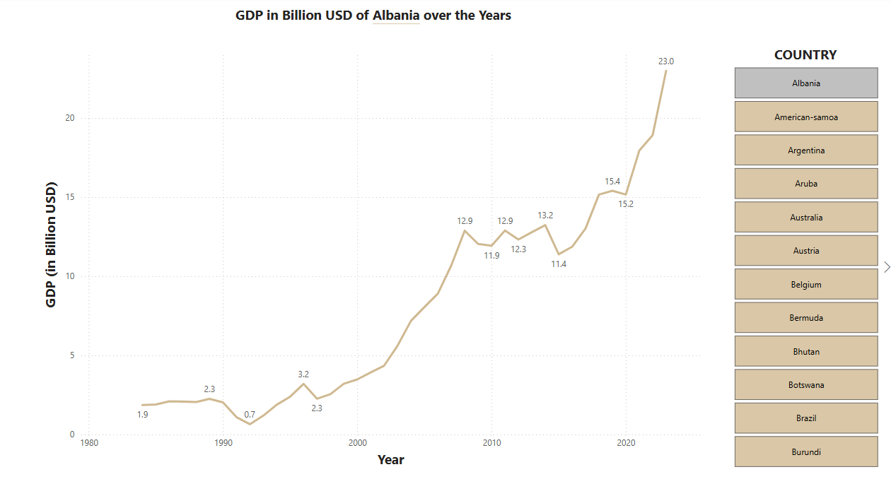
ECONOMICS - GDP

Slide 22
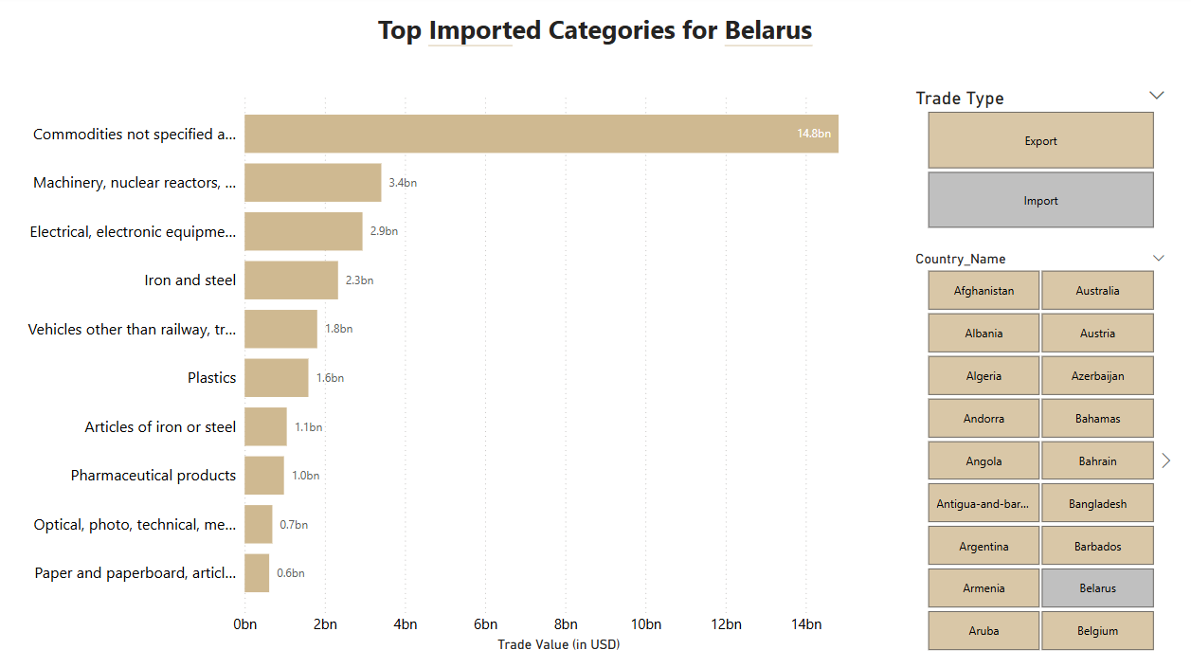
TRADE BY CATEGORY

Slide 23
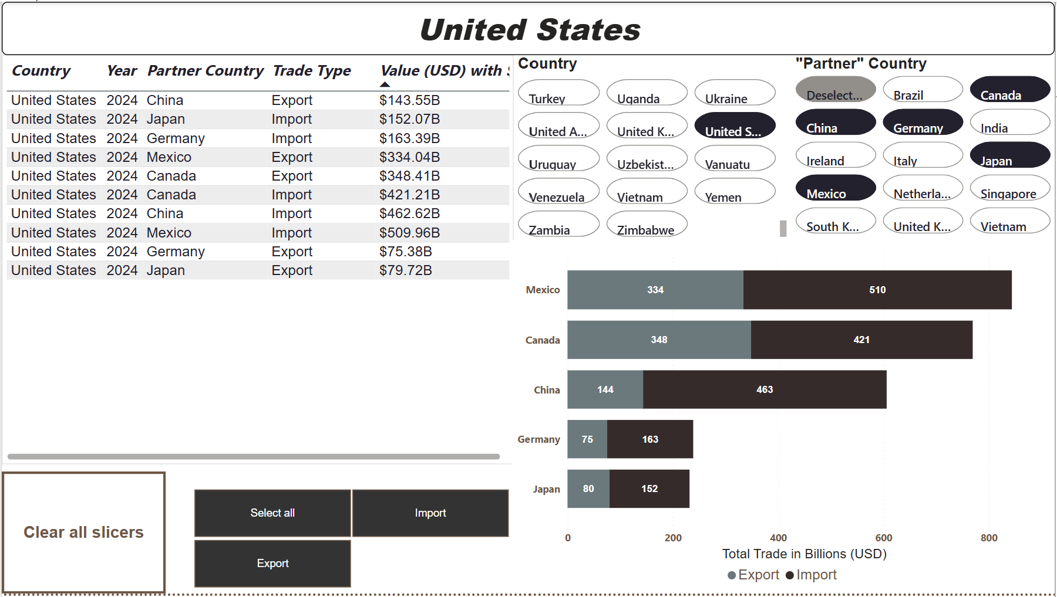
TRADE BY COUNTRIES

Slide 24
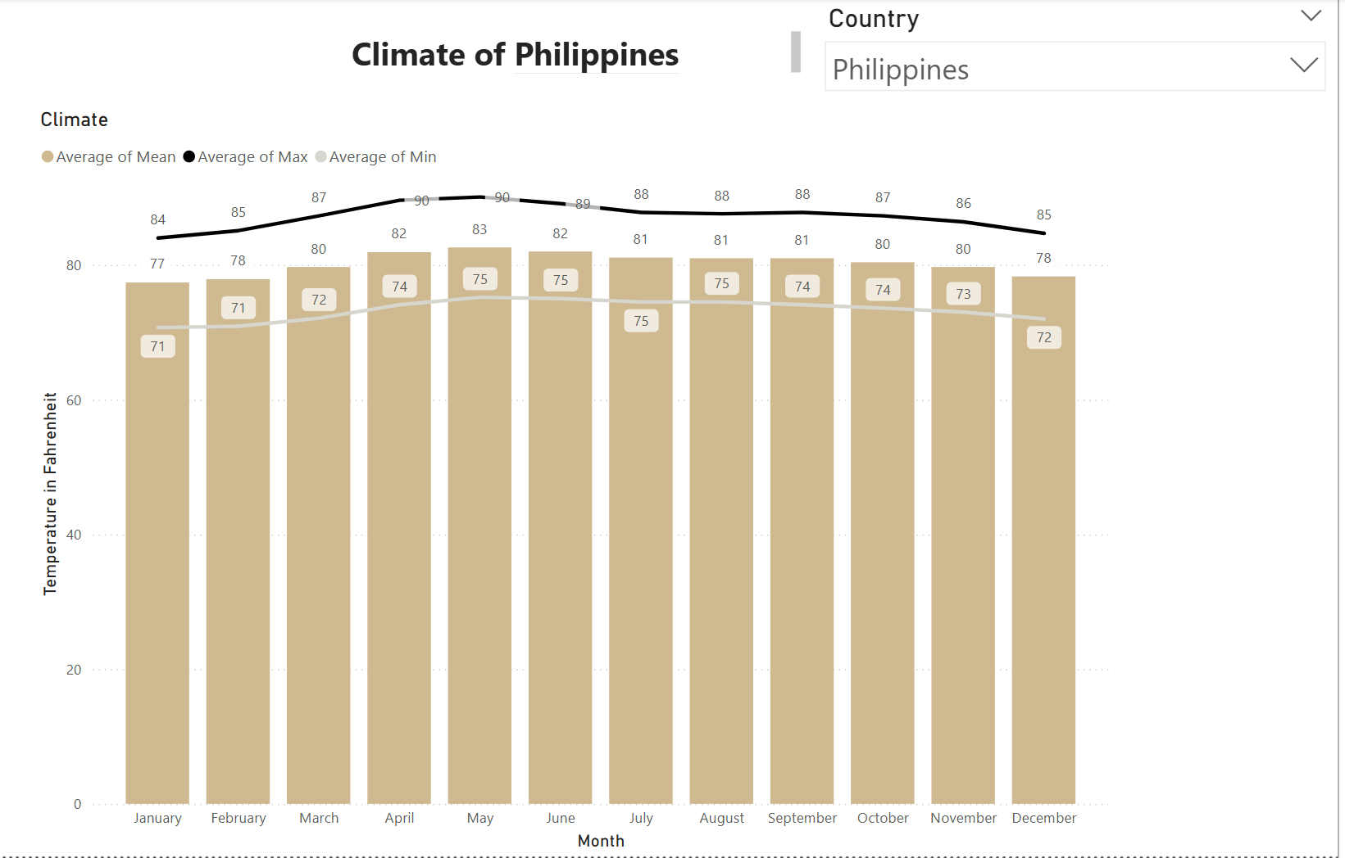
Climate

Slide 25
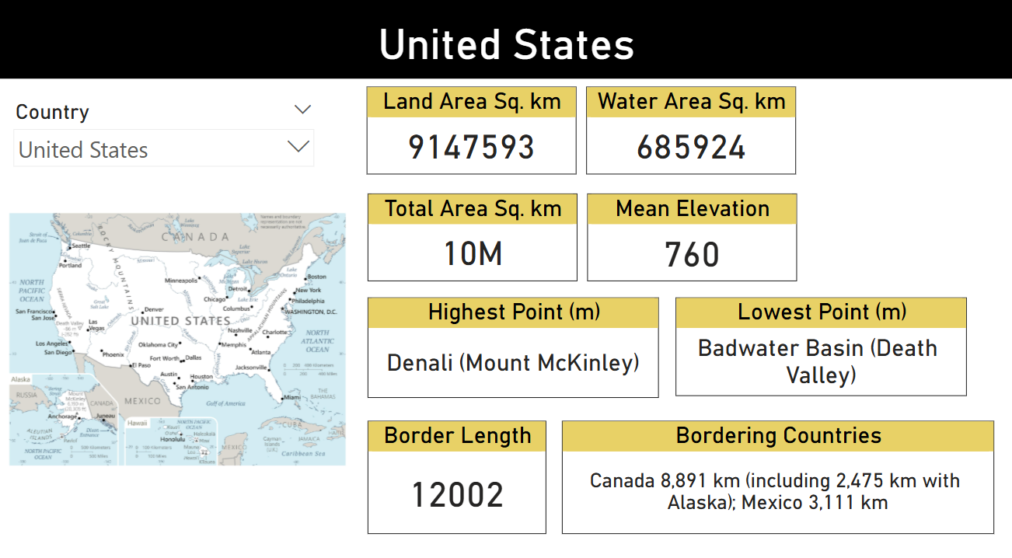
GEOGRAPHY

Slide 26
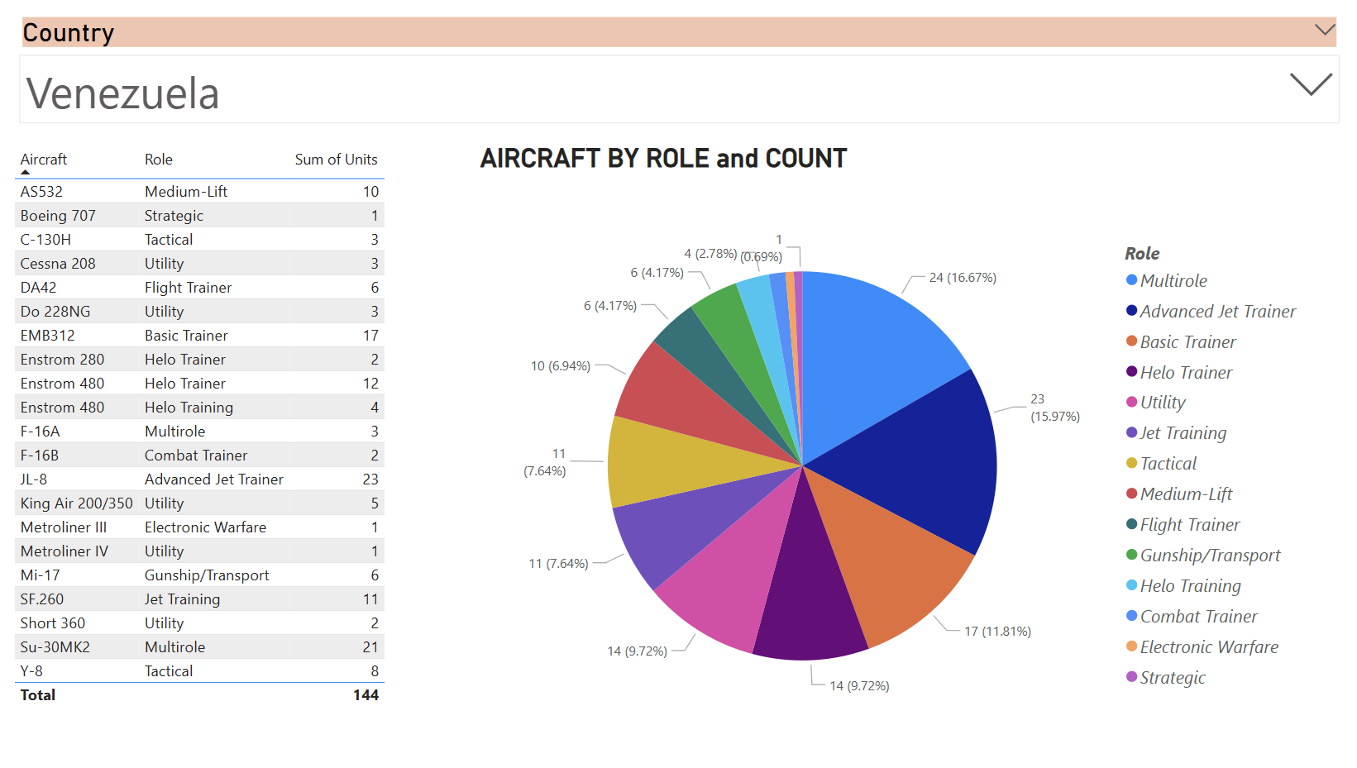
MILITARY – AIR POWER

Slide 27
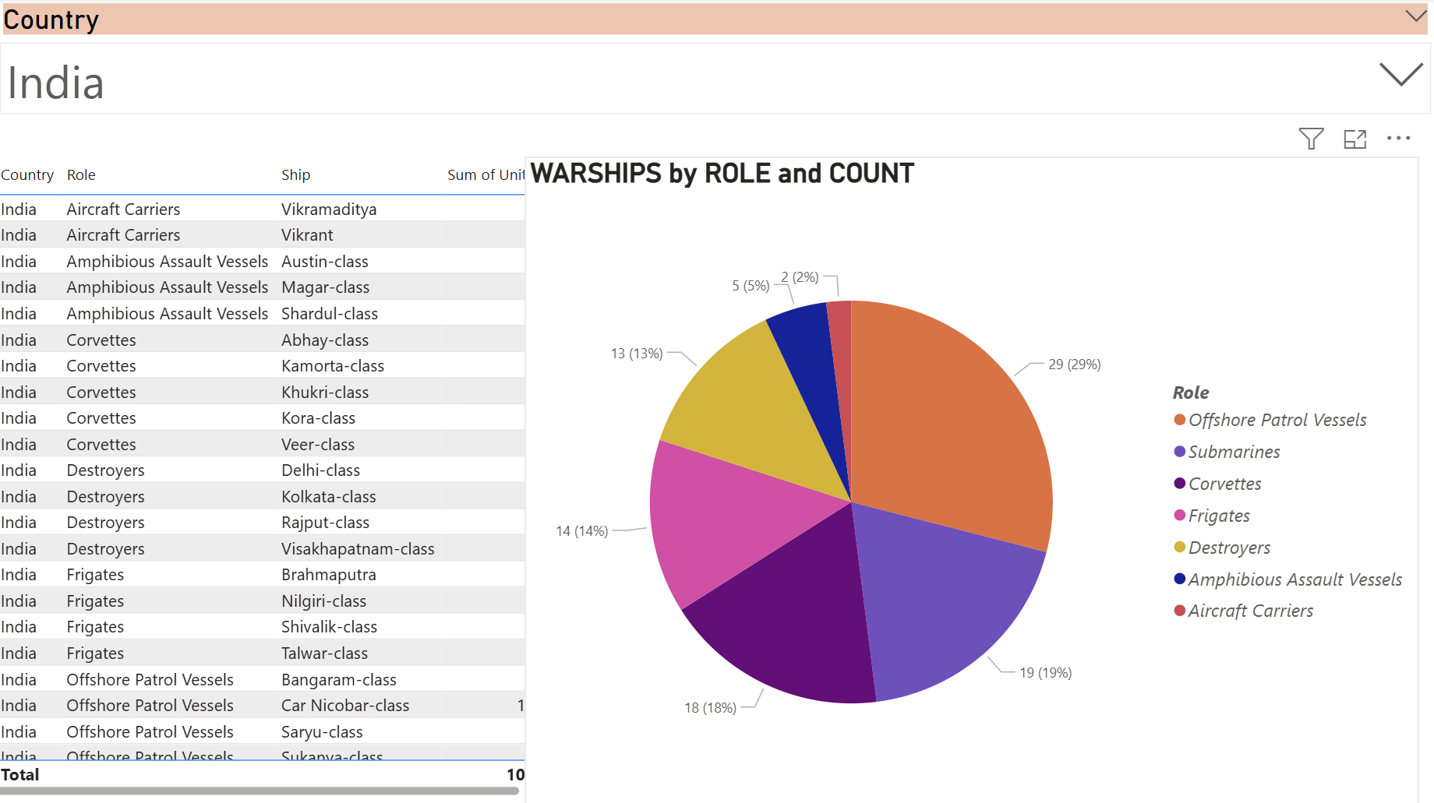
MILITARY – NAVAL POWER

Slide 28
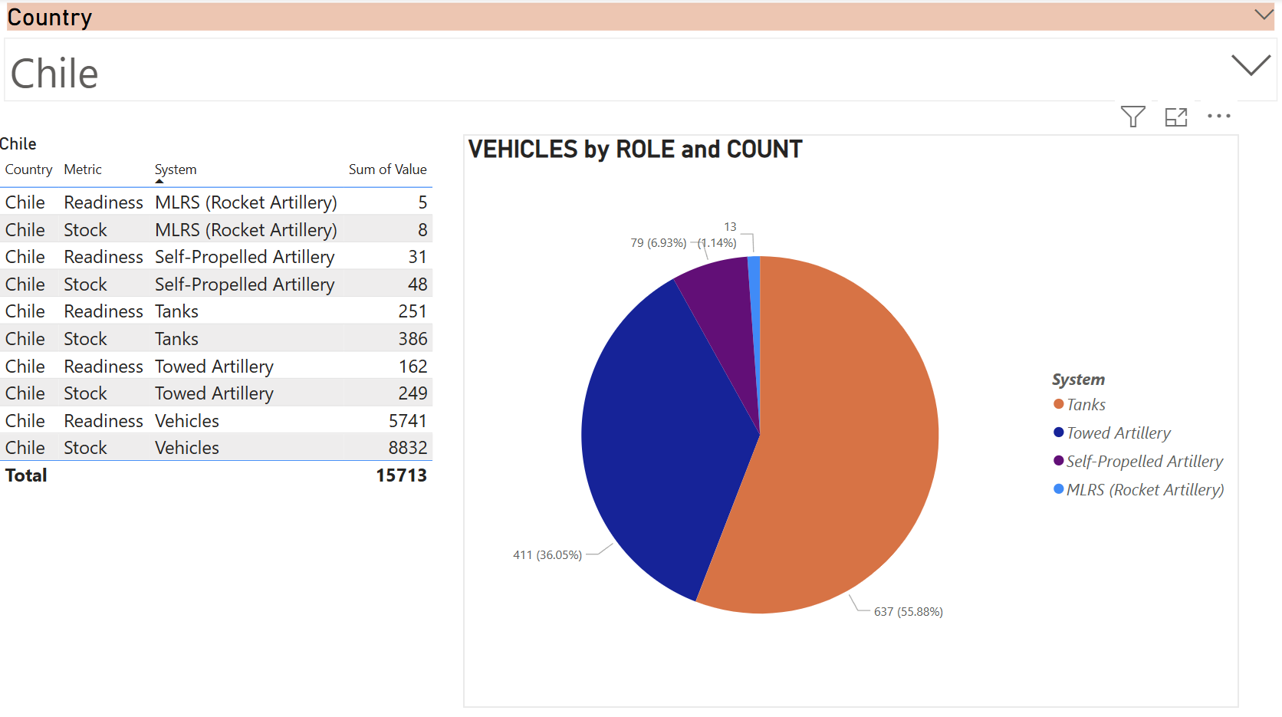
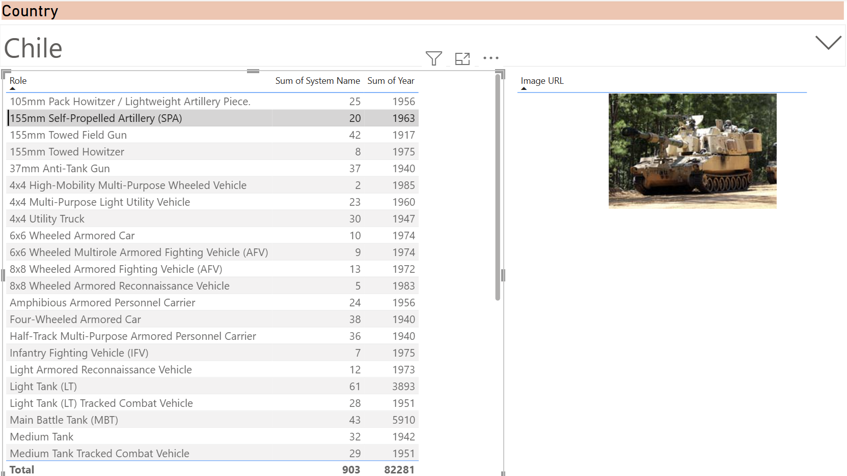
MILITARY – LAND POWER

Slide 29
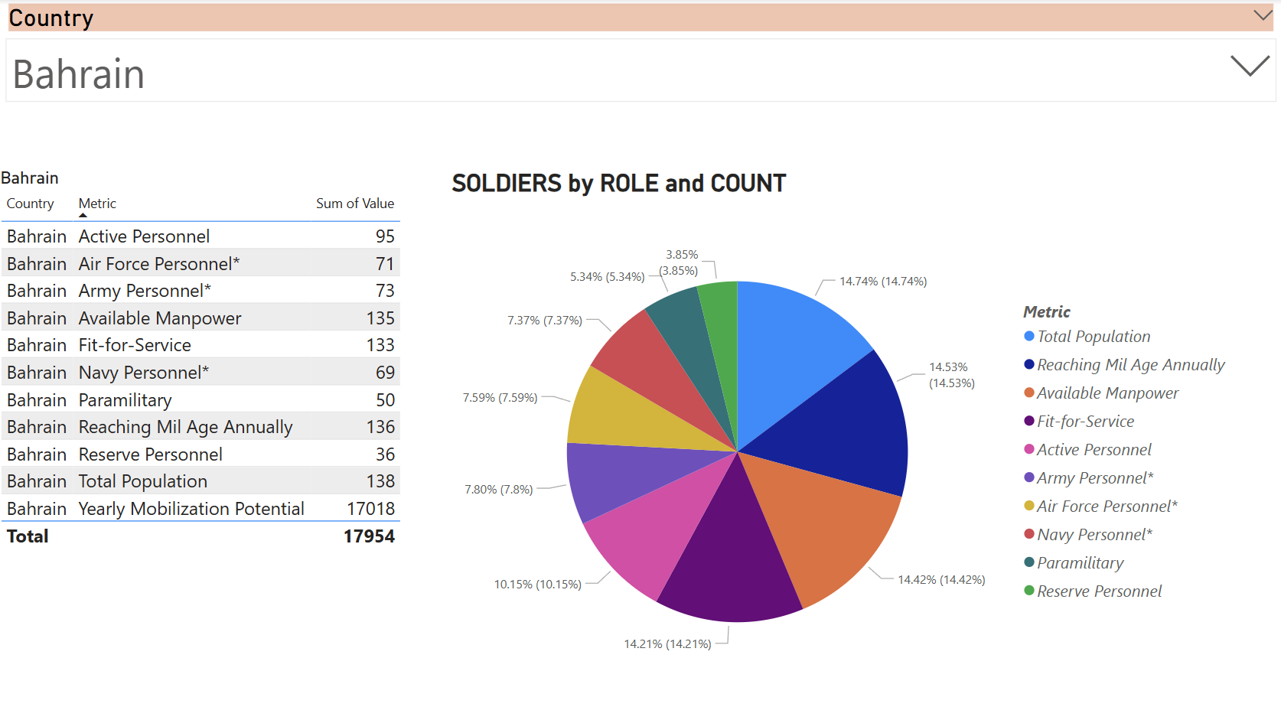
MILITARY – MAN POWER

Slide 30
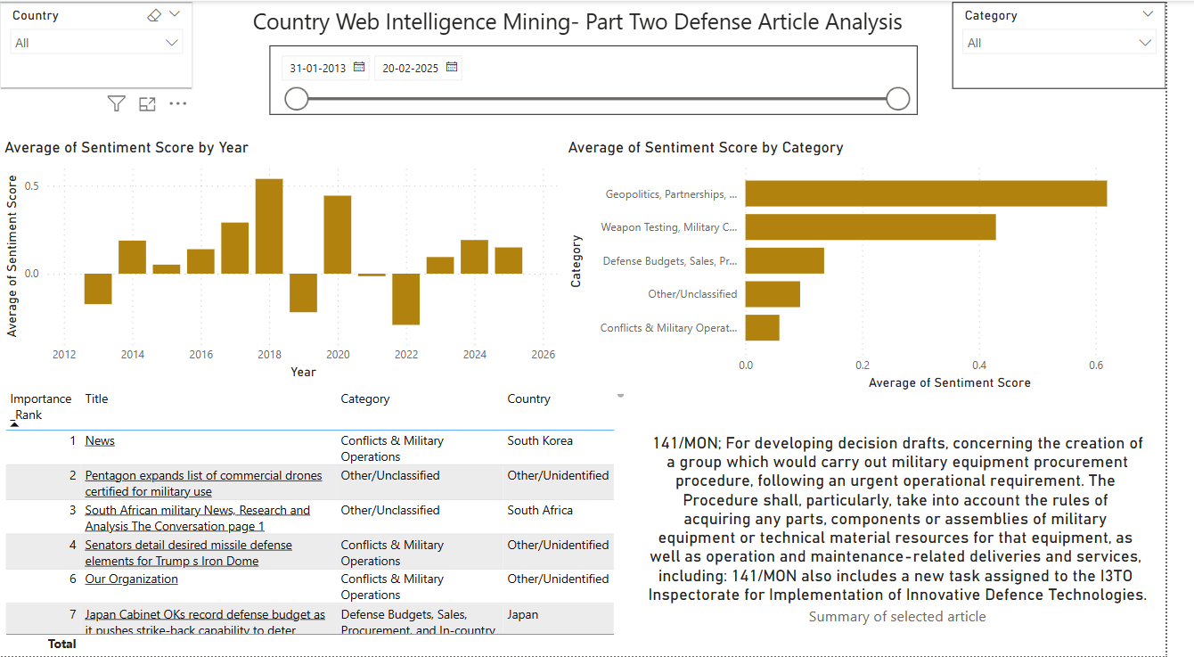
Part 2- DEFENSE ARTICLE ANALYSIS

Slide 31
Overview of Libraries & Functions Used
Libraries Used
Web Scraping & Data Retrieval: requests, BeautifulSoup, newspaper3k, serpapi
Natural Language Processing: nltk, transformers, VADER, sumy, re
Data Processing & ML: pandas, numpy, scikit-learn (TfidfVectorizer)
Will require an API key for google scraping which is free for the most part but if multiple pulls per day are needed it costs around 150USD per month for 15000
Key Functions & Their Role
Data Collection: fetch_page(), scrape_articles(), search_google_articles() – Ensures automated & diverse data collection.
Text Processing: clean_text(), extract_article_content(), summarize_article() – Prepares clean, structured text.
Sentiment & Stance Analysis: analyze_sentiment(), analyze_stance() – Determines tone & positioning of articles.
Categorization & Country Mapping: classify_category(), identify_country() – Segments articles by relevance.

Slide 32
Ranking and Importance Scoring
Ranking Method: TF-IDF
Why TF-IDF?
Relevance-Based: Identifies key terms & informative content.
Context-Aware: Filters out common words to highlight unique insights.
Scalable: Efficient for large datasets without manual intervention.
How It Works
TF (Term Frequency): Measures word occurrence in an article.
IDF (Inverse Document Frequency): Reduces weight of common words.
Final Score: Sum of TF-IDF values in the article’s summary.
Why Not Sentiment Scores?
Sentiment ≠ Importance (e.g., neutral news on military conflict could be more critical than a positive minor update).
TF-IDF focuses on information content, not emotional tone.

Slide 33



ACTIONABLE RESULTS
Saves 10+ hours per week of labor-intensive scraping.
On average, these improvements will save $2000 + per month.
This will free up 4-5 data analysts to work on other tasks.

Slide 34
SUMMARY
Business Problem
Assumptions
Approach + Decisions Taken
Code Operations + Outputs
Processing and Automation
PowerBI Dashboard Outputs Demo

Slide 35

Thank You
Questions?

Slide 36
ALTERNATIVE METHODS TRIED

Slide 37
AUTOMATING DATA SCRAPING WITH MICROSOFT POWER AUTOMATE
Overview:
Used Microsoft Power Automate with Agentic AI to streamline the scraping process.
Enabled quick, repeatable, and scalable data extraction.
Key Steps:
Set up an automated flow to fetch GDP data periodically.
Configured Agentic AI to adapt to website structure changes.
Integrated scraped data into a structured format for analysis.
Advantages:
Fully automated with minimal manual intervention.
More resilient to minor website structure changes.

Slide 38
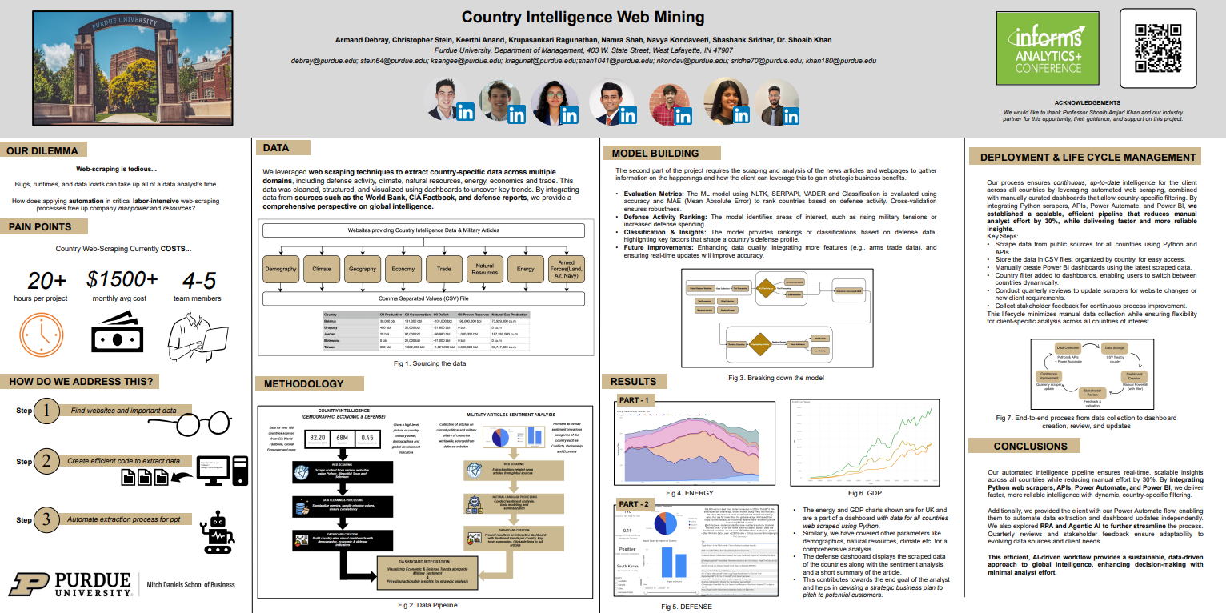
INFORMS POSTER

